Slide 1
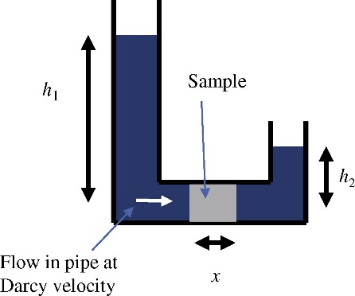
FIGURE 9.1 Schematic Diagram of Pressure Driven Flow

Slide 2
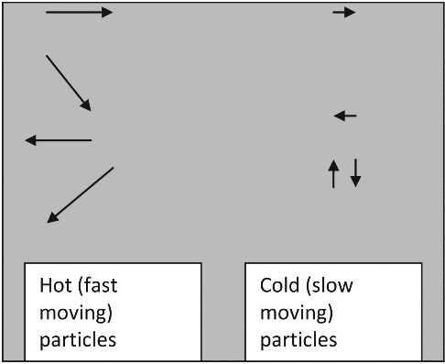
FIGURE 9.2 Schematic Diagram of Thermal Migration

Slide 3
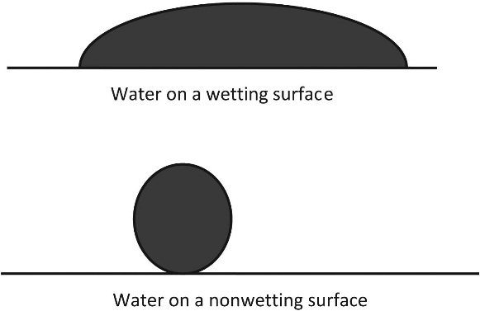
FIGURE 9.3 The Effect of Surface Tension

Slide 4
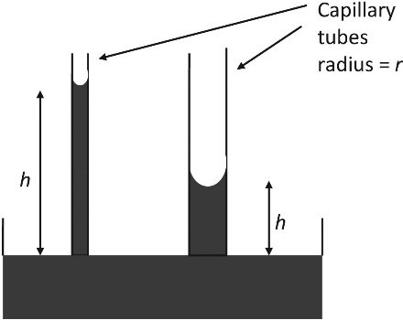
FIGURE 9.4 Capillary Suction Heights

Slide 5
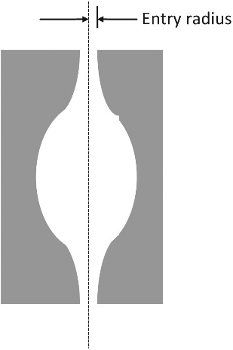
FIGURE 9.5 “Ink Bottle” Pore

Slide 6
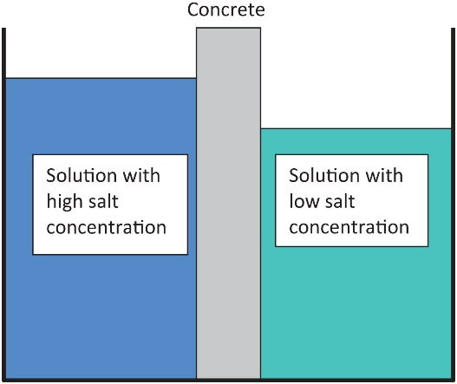
FIGURE 9.6 Schematic Diagram of Osmosis

Slide 7
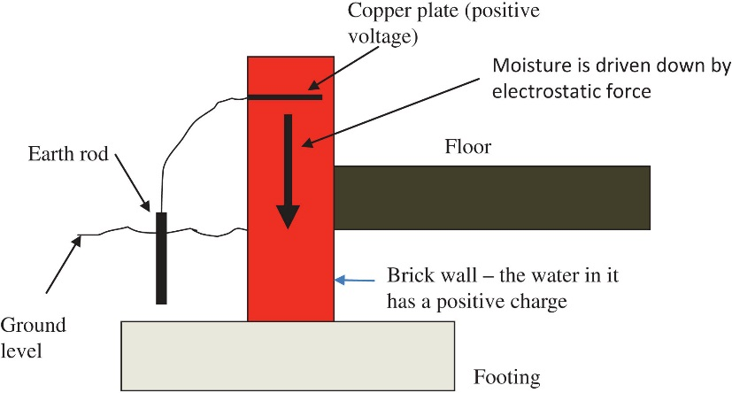
FIGURE 9.7 Arrangement of Electro-Osmosis System to Prevent Rising Damp in a Wall

